Slide 1
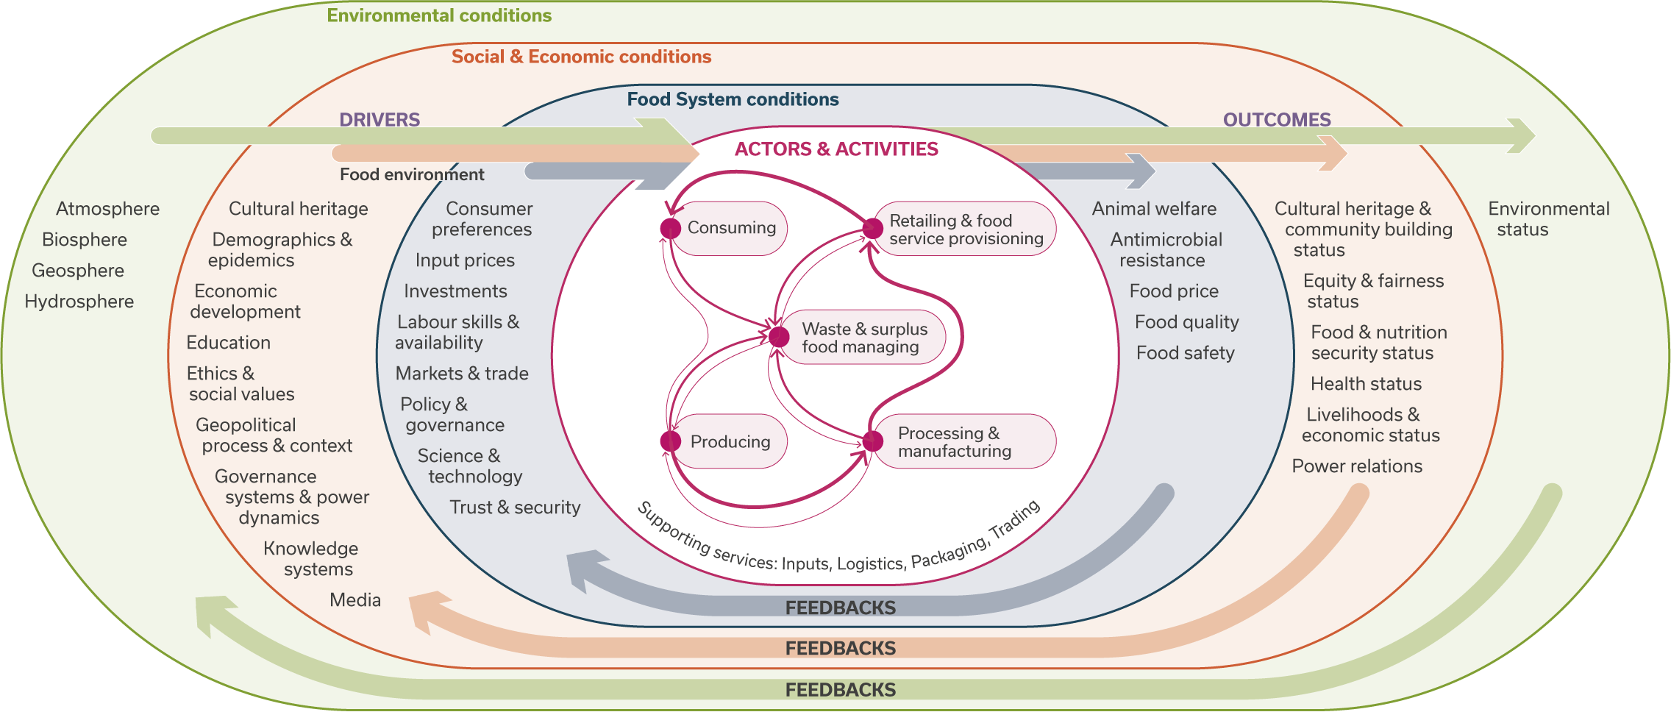
FoSSNet Conceptual Framework. This is a graphical representation of the food system designed to facilitate discussions on food system dynamics, food system management and food system science. The core food system ‘activities’ (and their corresponding ‘actors’) are shown in the central circle with supporting services applying to them all. The thickness of the red arrows represents the relative amount of material flow between given activities. The arrows originating in the ‘drivers’ areas coalesce to indicate their integrative nature, while the arrows leading to the ‘outcome’ areas are independent of each other but collectively all apply. The framework does not include spatial or time dimensions, nor power dynamics as these issues are very case specific. It therefore needs to be seen as a tool to help guide research and stakeholder discussions for given circumstances.

Slide 2
And so why ‘food system science’?*
What? Food System Science (FSS) is the interdisciplinary study of food system drivers, core activities, outcomes and feedbacks, and their dynamic, two-way relationships across time and space.
How? FSS requires a systems approach to integrate diverse knowledges in an independent, transparent, democratic, participatory, fair and equitable way, recognising social, cultural, political, economic and biophysical contexts.
Why? FSS is needed to better understand and foster transformative action in policy and practice on innovation, conservation, restoration and exnovation in interconnected social, economic and biophysical systems. Such action helps transition towards more sustainable, resilient, and nature- and people-positive food systems.
* Draft ‘Food System Science’ definition, still under development

